Slide 1
Influences: 10 clover field lane
A “Dan Trachtenberg” film
Chou Liang wei

Slide 2
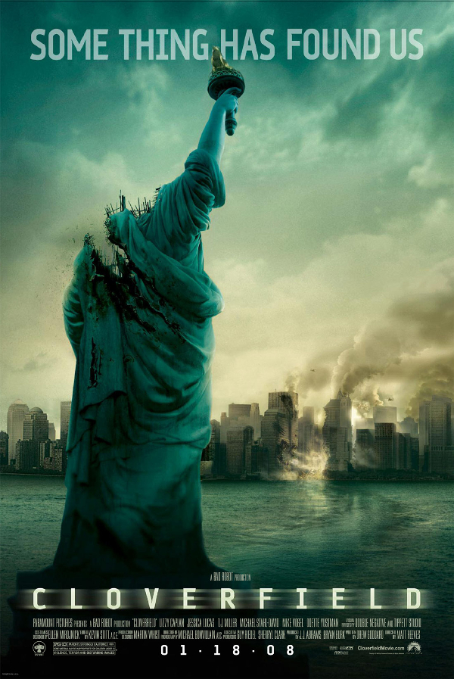
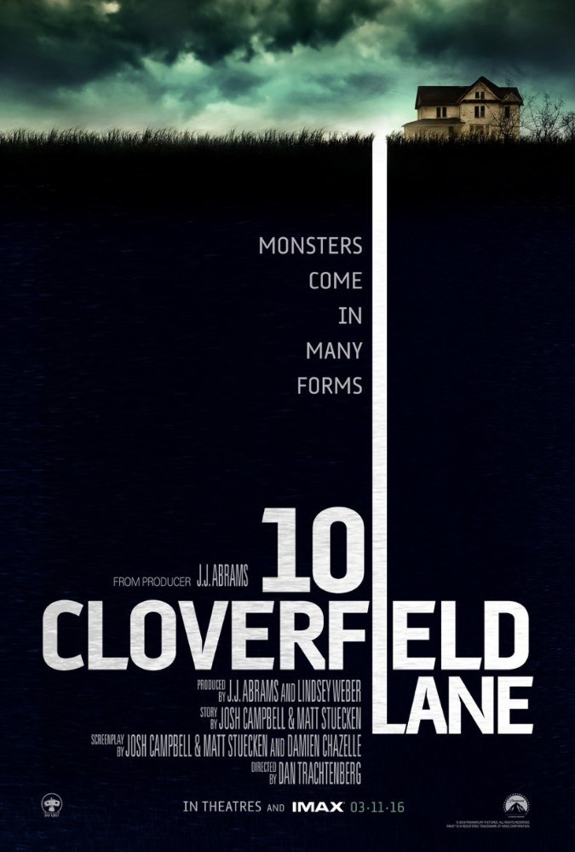
Sci-Fi Thriller film spiritual sequels

Slide 3
A successful thriller film
Suspense
Mislead audience
Music
Foreshadows
Imply

Slide 4
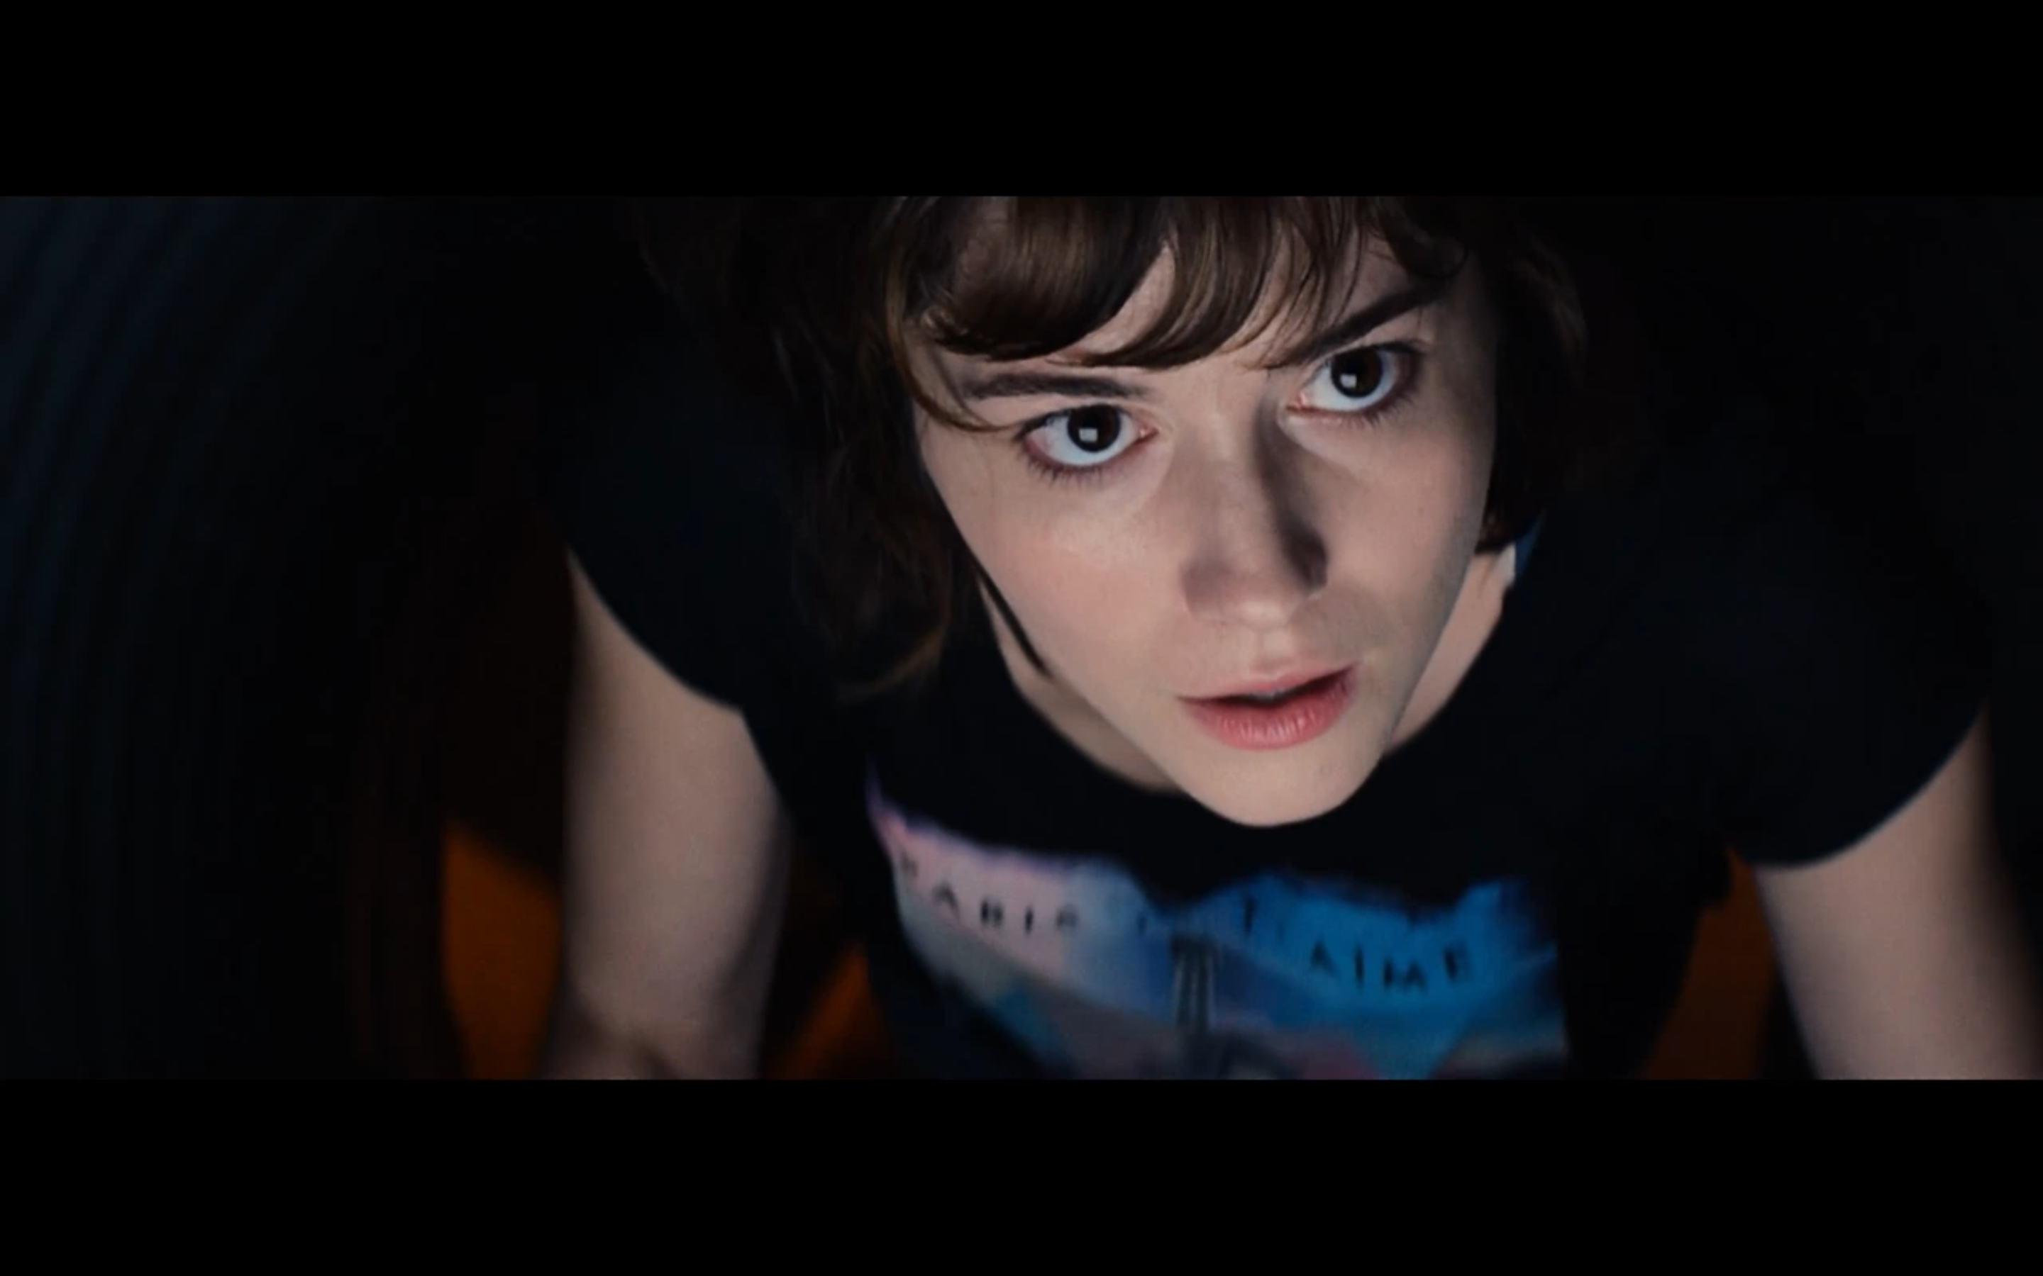
Character

Slide 5
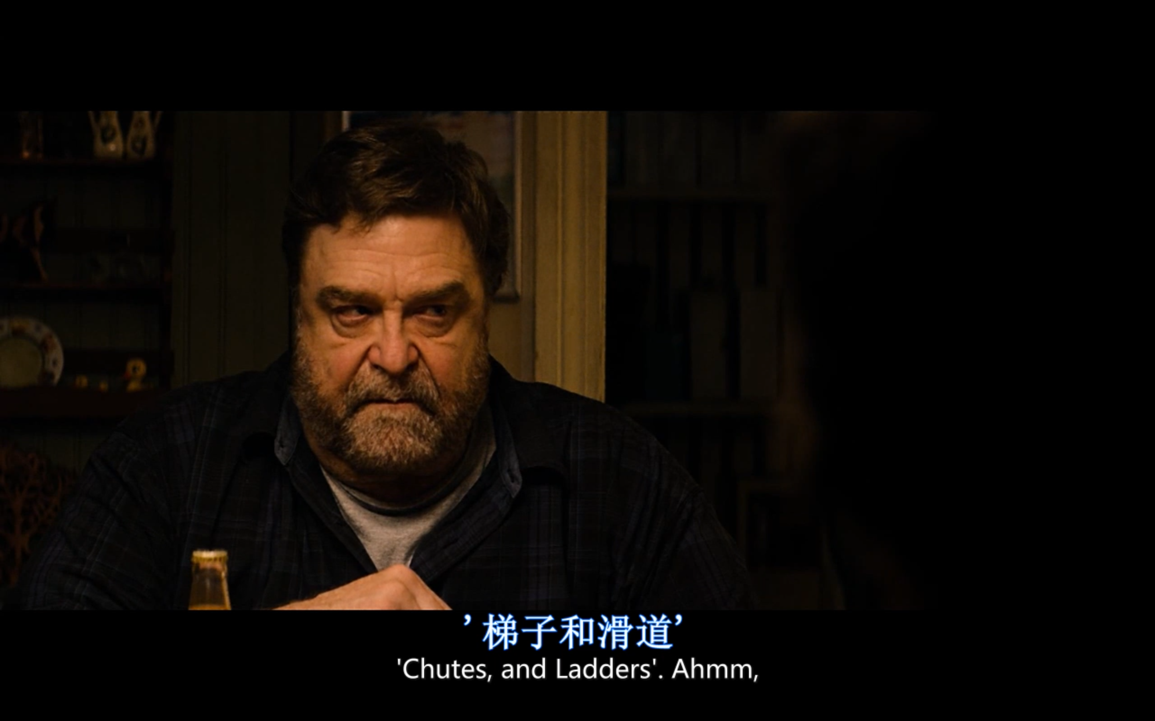

Slide 6
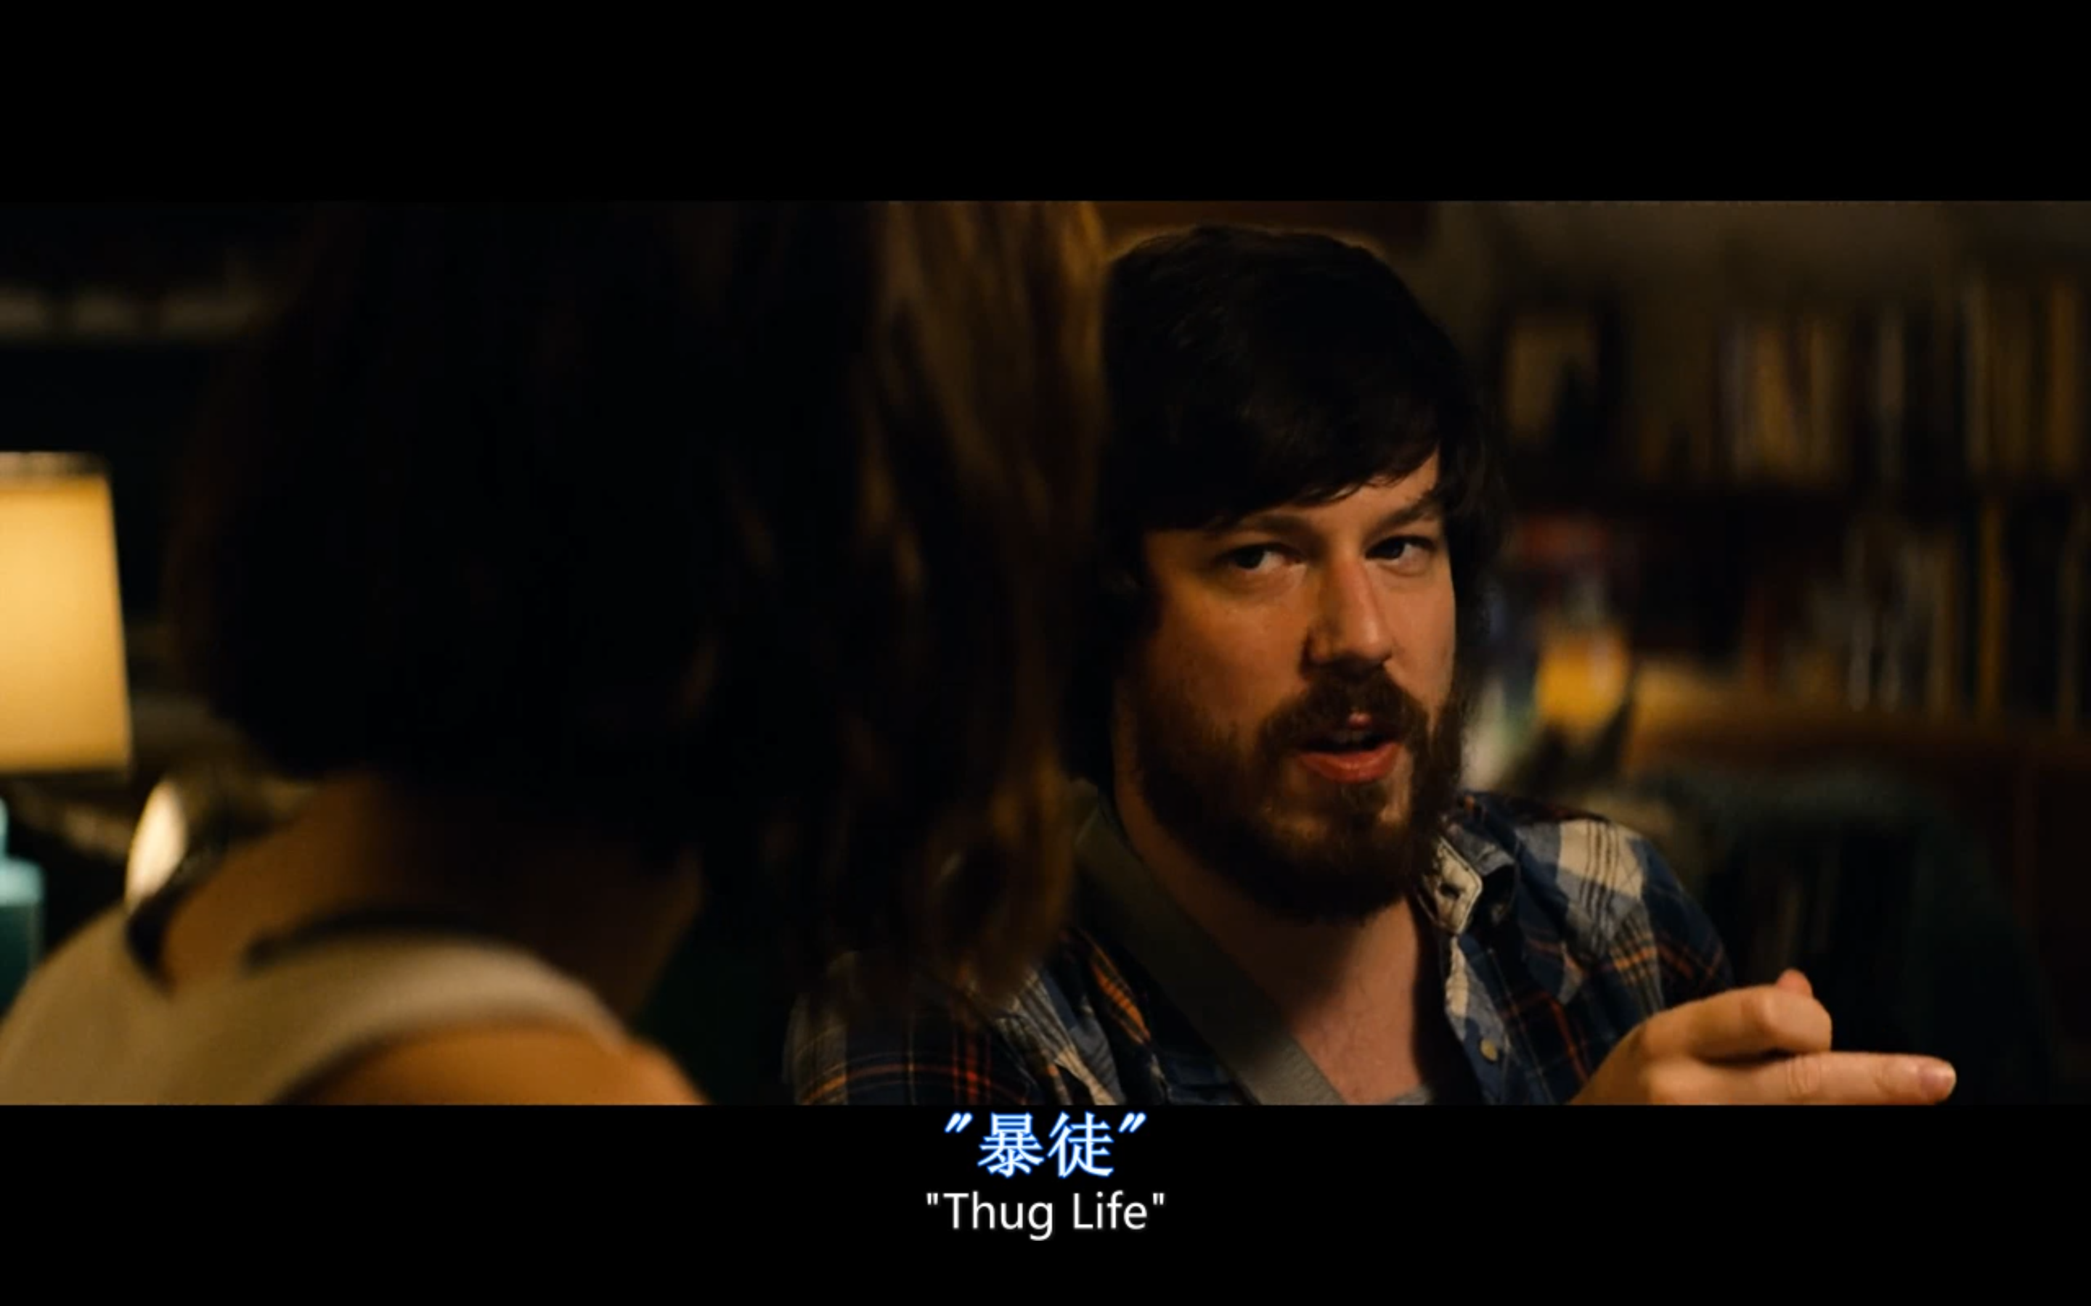

Slide 7
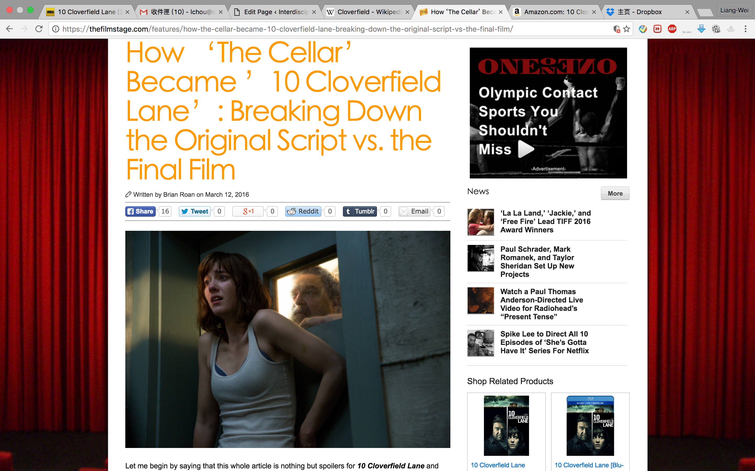
Script

Slide 8
